Slide 1
Learn to speak
like normal people do:
the case of object descriptions
Michael Zock | Guy Lapalme | Mehdi Yousfi-Monod
LIF-CNRS, University of Marseille France | RALI-DIRO Université of Montréal Canada | NEIIO Montpellier France
michael.zock@lif.univ-mrs.fr | lapalme@iro.umontreal.ca | mehdi.yousfi@gmail.com

Slide 2
Goal
Help students to acquire the needed knowledge to refer properly to ‘objects’.
learn not only to speak correctly
  communicate effectively, i.e. efficiently
1

Slide 3
1° Nature of the problem
  What can be referred to?
  concrete objects (dog, pen, book)
  ideas, domains (cognitive science, sports, world cup, )
  How ?
  pointing (objects in real world, text elements)
  naming (John, Puneet, Roberto)
  descriptions
    attributes (the tall one)
    relations (his daughter)
  pronouns (they, he, she, it)
  combination of some of these (the bus you've taken for Stockholm)
2

Slide 4
1° Nature of the problem
  Conceptual level (deep generation)
  what information to give in order to allow the listener to identify the intended object?
  Linguistic level (surface generation)
  if there are several attributes, in what order to present them?
    hot black coffee vs. black hot coffee
    dangereous fish vs. shark
3

Slide 5
1° Nature of the problem
  First mention
  full description (once upon a time there was a king....)
  Subsequent reference
  definite description (the/this king)
  abbreviated reference (this king, he....)
4

Slide 6
Referring expressions, source of potential misunderstandings
  Even highly experienced speakers sometimes fail to evoke the intended object in the listener's mind, causing misunderstandings:
  Uncle Henry: You say Dorothy bit you.
  Neighbor lady: No her dog.
  Uncle Henry: Oh, she bit her dog.
  Obviously, here is a problem concerning the object in focus : agent/patient.
5

Slide 7
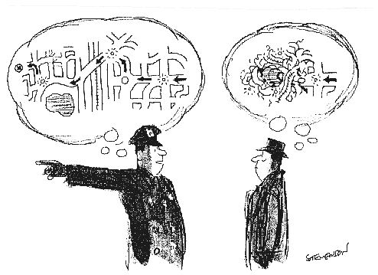
2° Why are they difficult ?
  Giving directions
  Problem to be solved : receive instructions of how to get to a specific place?
  Problem: get precise reference points
6

Slide 8
Poor instruction
  Goal: Find out at what stop to get off the bus
Context : on a bus in London,
Q A to B: Where shall I get off in order to reach Piccadilly Circus?
B’s answer: Get off at the stop just before mine.
While this may well be a distinguishing description of the intended referent, it is probably not of much use, as, by the time B leaves the bus, A will have missed already the stop s/he would have liked to get off.
Appelt, D. (1985). Planning English Referring Expressions.
Cambridge University Press, New York.
7

Slide 9
2° Why are they difficult ?
  Describing objects
  Goal : calling for attention (dad)
  Problem : ambiguity
  While from the caller’s point of view (child) there will be only one ‘dad’, from the dads’ point of view (waiting in front of the school for their children to get out), there are many potential dads this voice is calling for.
8

Slide 10
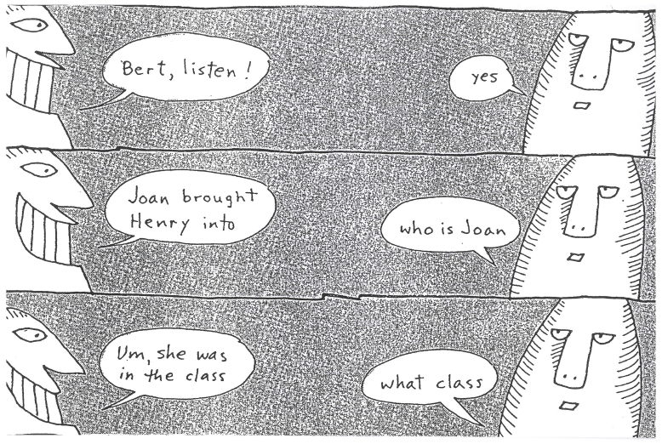
Aboutness : egocentric speaker
9

Slide 11
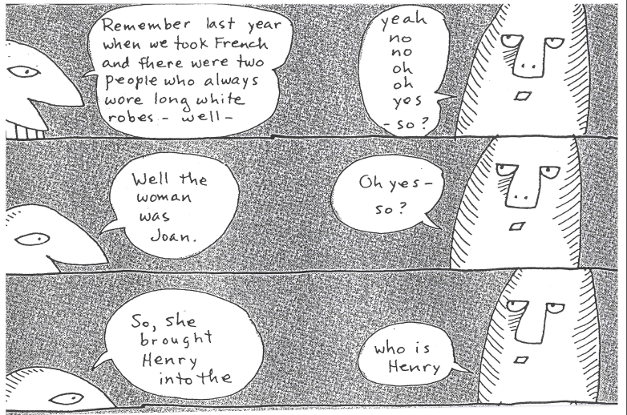
Aboutness-continued
10

Slide 12
How to characterize properly
a given object?
11

Slide 13
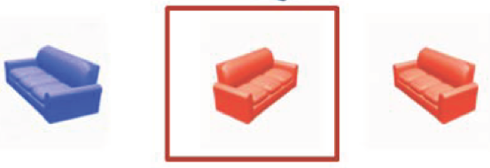
Situation composed of the following 3 objects : 1 target and 2 possible distractors
target
The couch (underspecified, ambiguity)
The red sofa facing right (overspecified)
The sofa facing right (well-specified/minimal)
12

Slide 14
3° Web-based application
(3 attempts to help the language learner)
  How to characterize an object ?
  Find the target among a set of candidates
  Decide on the correct referring expression
  Accessible at the following website :
  WebREG
13

Slide 15
http://www-labs.iro.umontreal.ca/~lapalme/WebREG/index.php?act=1
3.1 How to characterize an object?
14

Slide 16
http://www-labs.iro.umontreal.ca/~lapalme/WebREG/index.php?act=2
3.2 Find the target among a set of candidates
15

Slide 17
http://www-labs.iro.umontreal.ca/~lapalme/WebREG/index.php?act=3
3.3 Decide on the correct expression
16

Slide 18

How to overcome
the problem
with the help of a computer?
17

Slide 19
Context
Problem: speaker/writer fails to access a word
Solution: build a resource allowing authors to find quickly and naturally the elusive word
Question : how?
18

Slide 20
Outline
What is the tip of the tongue problem (ToT) ?
What causes it ?
How to overcome it?
  Why can’t we use the human brain as model?
  How to achieve nevertheless something equivalent?
Search scenario
  How to reduce optimally the search space without cutting off the branch we are sitting on?
How to build the resource?
  Corpora
  Crowdsourcing
Bottlenecks
19

Slide 21
What is the tip of the tongue problem?
The ToT-problem is the state an author is in when he knows a word but cannot (fully) access it (in time).
The fact that the author knows the word is often revealed by the fact that
  s/he can recall it later on or when being given some hints;
  s/he can spot it right away in a list containing the target.
The authors know a lot concerning the target word:
  meaning (defining elements);
  number of syllables (in particular the first and last one)
  other words related by meaning, sound or association (co-occurrences: rose-red)
Of all the information necessary to produce a word (meaning, form, sound), it is generally the last component that lacks completion.
20

Slide 22
What causes it?
Lack of energy: this may be due to lack of usage. The author hasn’t used or read the word recently.
Priming: a somehow related element may interfere with the target:
  semantics : take the first one to the left (target: right)
  morphology : slicely thinned (target: thinly sliced)
  sound/phonology : histerical (target: historical)
21

Slide 23
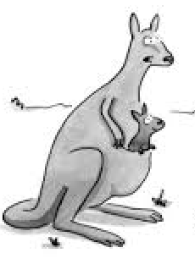
What causes it ?
What’s
that?
conceptual
Lexical
concept
Segments
phonemes
Possible causes
weak links
competition
interference (trivial)
22

Slide 24
Levelt’s
model
23

Slide 25
How to overcome it?
Why can’t we use the brain or the mental lexicon as model?
How to achieve nevertheless something equivalent?
24

Slide 26
How to overcome it?
Why can’t we use the brain or the mental lexicon as model?
Words in books and in the brain are fundamentally different:
  in dictionaries they exist as holistic entities: word definitions (meaning) and word forms are represented together.
  in the brain they are decomposed. The elements representing meaning, form, sound are distributed over various layers, yet all of these elements need to be activated (not accessed) in order to yield the desired word word form. Note that activation takes not only time it is also error prone.
  In sum, one may question the very fact that words are represented as holistic entities (symbolically) in our mind.
25

Slide 27
How to overcome it?
How to achieve nevertheless something equivalent?
Create an association network where all words are linked either by typed or untyped associations. Since authors always know something about the target, they will enter the network by using this item as starting point, navigating from the source-word (word coming to their mind) to the target, which is generally in close vicinity.
Knowledge of the relationship between the source and the target is an obvious asset, as it reduces considerably the search space.
26

Slide 28
Various kinds of relations :
meaning-related (1-13), form-related (15-19) or both (14)
 | Type of relation | Description of the relation | prime-target
1 2 | Hypernym Hyponym | a more general word a more specific word | pie-pastry fruit-nut
3a 3b 3c | Meronym_substance Meronym_part_of Meronym_member_of | a concept being a substance of another concept a concept being part of another concept a concept being a member of another concept | blood-body ship-fleet kid-family
4a 4b 4c | Holonym_substance Holonym_part_of Holonym_member_of | a concept having another concept as substance a concept having another concept as part a concept having another concept as member | sea-salt tree-leave team-player
5 | Cause to | a verb expressing the cause of a result | kill-die
6 | Entailment | a verb expressing an unavoidable result | buy-have
27

Slide 29
 | Type of relation | Description of the relation | prime-target
7 | Troponym | a specific way to perform an action | drink-sip
8 | Part_of_meaning | part of the target word's definition | butter - milk
9 | Quality | typical quality, or inherent feature | snow - cold
10 | Co-occurrence | two concepts occuring frequently together | blue - sky
11 | Topically related | two concepts related by topic | sea - tide
12 | Used_for | instrumentally related words | fork - eating
13 | Made_of | substance or element used to make <object> | glass - sand
28

Slide 30
 | Type of relation | Description of the relation | prime-target
14 | Free association | any kind of link between two words (often hard to name, i.e. make explicit) | door - open
15 16 | Synonym Antonym | word expressing basically the same meaning a word meaning the opposite | cup-mug dry-wet
17 | Sound (rhyme) | two similar sounding words | bad - mad/sad
18 | Homophones | words sounding alike, but spelled differently | right - write
19 | Anagrams | composed of same or similar components | cheater - teacher
Form relations : 15-19
29

Slide 31
How to overcome it?
How to achieve nevertheless something equivalent?
A note concerning the links : both kinds of links (type/untyped) are necessary for filtering, i.e. to ensure that the search space is neither too big (typed links), nor too small (untyped links).
Untyped links are a necessary evil allowing us to include into the search space direct neighbors of the source-word eventhough we are not able qualify the nature of the link. If we didn’t include them, we would loose precious potential target words.
30

Slide 32
Search scenario
word we are looking for (target word) nurse
word coming to our mind (source word) hospital
31

Slide 33
Links must be interpretable
to allow for navigation
32

Slide 34
Show only what’s useful: cluster words by link types
Internal representation
Link type words
AKO
    clinic
    sanatorium
ISA
    military hospital
    psychiatric hospital
ACTOR
    doctor
    patient
    nurse
33

Slide 35
Don’t drown the user: ease navigation
34

Slide 36
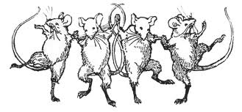
Plan A- the 3 principal steps
The mice are dancing.
35

Slide 37
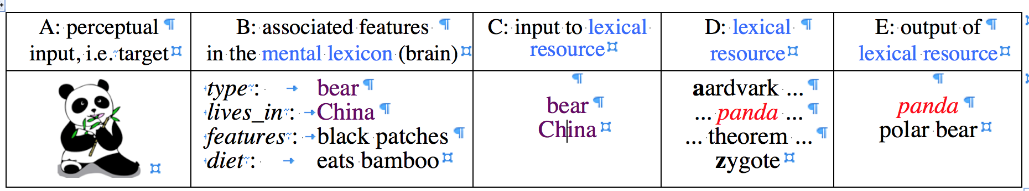
Lexical access a two-step process mediated by the brain and an external resource (lexicon).
User input
Syst. output
Wanted
Target word form
Found
Target
word form
36

Slide 38

Idea to express
Entire lexicon
Hypothetical size:
60.000 words
37
Notes:
This picture shows the roadmap of how we plan to tackle the Tip-of-the Tongue State (TOT), or how to overcome it with the help of a computer or mobile device
A : In order to be able to access a word, it must be stored. This is done in the lexicon.
Yet, we never search in the entire lexicon, rather we search in a sub-section.
B: Given some input from the user (say 'coffee'), the system will present a subset, likely to contain the target word.
This subset is basically a semantic network where all words are connected. Search consists in entering this network and to follow the links until one has reached the target word.
The network is built on the basis of associations. Words are organized not alphabetically or by topic or semantic field (food, movement verbs, ...) but by the associations they evoke : black → coffee, night, .... This networks can be built automatically by extracting co-occurences in a corpus. The window being generally a sentence or a paragraph. An alternative is to use an existing resource, like the EAT (Edinburgh Association Thesaurus) which contains all words that people typically associate with a term.
Once the user has provided some input (say, 'black') the system will display all DIRECTLY associated words. (B)
Since the number of words associated with the input is huge (see B) we suggest to cluster this list and to lable the cluster (step-2, system builder). The result will be a categorial tree allowing the user to navigate in the tree in order to locate quickly the target word.

Slide 39
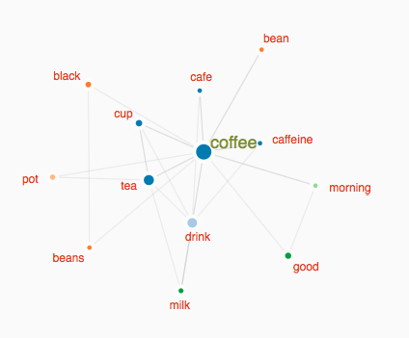
Roadmap
Step-1
  given some input, source word, build a graph with all direct neighbors (output) ==> lexical graph or association network;
http://www.smallworldofwords.com/new/visualize/#
http://www.eat.rl.ac.uk/cgi-bin/eat-server
38

Slide 40
Roadmap
Step-2
  cluster and label the words produced in response to some input (build a categorial tree). Suppose the input to be 'coffee', with the target word being 'mocha'.
Direct neighbors of ''coffee'
http://www.eat.rl.ac.uk/cgi-bin/eat-server
Categorial tree corresponding to the output (direct neighbors)
Produced in response to the input (source-word : ocoffee)
39

Slide 41
How to access the word stuck on the tip of your tongue?
40
Notes:
This picture shows the roadmap of how we plan to tackle the Tip-of-the Tongue State (TOT), or how to overcome it with the help of a computer or mobile device
A : In order to be able to access a word, it must be stored. This is done in the lexicon.
Yet, we never search in the entire lexicon, rather we search in a sub-section.
B: Given some input from the user (say 'coffee'), the system will present a subset, likely to contain the target word.
This subset is basically a semantic network where all words are connected. Search consists in entering this network and to follow the links until one has reached the target word.
The network is built on the basis of associations. Words are organized not alphabetically or by topic or semantic field (food, movement verbs, ...) but by the associations they evoke : black → coffee, night, .... This networks can be built automatically by extracting co-occurences in a corpus. The window being generally a sentence or a paragraph. An alternative is to use an existing resource, like the EAT (Edinburgh Association Thesaurus) which contains all words that people typically associate with a term.
Once the user has provided some input (say, 'black') the system will display all DIRECTLY associated words. (B)
Since the number of words associated with the input is huge (see B) we suggest to cluster this list and to lable the cluster (step-2, system builder). The result will be a categorial tree allowing the user to navigate in the tree in order to locate quickly the target word.

Slide 42
Conclusion
My goal was to provide some evidence concerning the importance of the human factor when building AI.
To enlargen its scope and to act in concert with people AI must produce outputs that are interpretable by human users.
To allow for this engineers must take into account (at least some) features of the human user. It remains to be seen which ones should be taken into account, and how to achieve this.
I've also shown that communication appeals next to our intellect (knowledge, knowledge states) to our feelings or emotions. This being so, we have to address them both.
41

Slide 43
Need of defining a new partnership
Obviously, humans and machines have different qualities and shortcomings, yet, taken together they could form a dreamteam.
Still, while the results produced by a machine often need to be understandable by people, we should not expect the machine to produce this behavior in the same way as humans do. After all, we are far from perfect, facing many problems inexistant for machines: ego, motivation, emotion, fatigue, speed, strength, …
Even if machines outperform humans in various respects, we don’t want to create a brave new world. What we may want to do though is to create a situation offering us the best of two (different) worlds. Yet to achieve this, we must take a holistic approach, a point righteously made by the organizers of this workshop.
42

Slide 44
One last word
Sure, "this is not the end.
It is not even the beginning of the end,
but perhaps, it's the end of the beginning"
(W. Churchill)
43

